Slide 1

HOW DID ONE COMPANY BECOME THE BACKBONE OF AI?
NVIDIA: FROM GAMING STARTUP TO THE ENGINE OF THE AI REVOLUTION

Slide 2

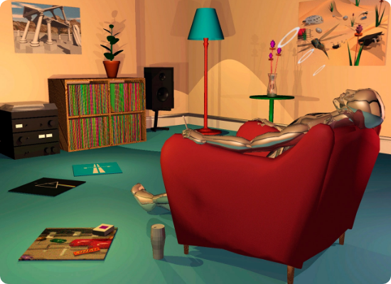
THE GAMING COMPANY
Founded in 1993 by Jensen Huang, Chris Malachowsky, and Curtis Priem.
The Mission: Build better computer graphics chips. At the time, 3D graphics and gaming were considered a risky, niche market.
The Vision: They bet on the future before the AI boom existed, believing visual computing would become a major form of computing.
This early vision quietly laid the groundwork for something far larger than gaming.

Slide 3
THE EARLY BATTLES
1997: RIVA 128
A dramatic comeback. NVIDIA pivoted to triangle-based rendering, shipping a fast, compatible GPU that won back developers.
1995: NV1
1999: GeForce 256
Launched using an unconventional curved-surface rendering approach. Misaligned with Microsoft's emerging DirectX triangle standard.
Marketed as the world's first GPU. Shifted intensive geometry calculations from the CPU, establishing massively parallel processing.

Slide 4




CPU VS GPU: WHY GPUS CHANGE THE GAME
CPU — The Expert Specialist
GPU — The Parallel Powerhouse
A CPU has a few powerful cores, each optimized for complex, varied, and sequential tasks. Think of it as a small team of highly skilled experts.
A GPU has thousands of smaller cores designed to perform the same calculation simultaneously across massive datasets.
Strengths: Running operating systems, applications, and logic-heavy workloads that require quick decisions and varied instructions.
Strengths: Ideal for repetitive, large-scale math. Think of it as a huge workforce all doing one simple task at once in parallel.

Slide 5
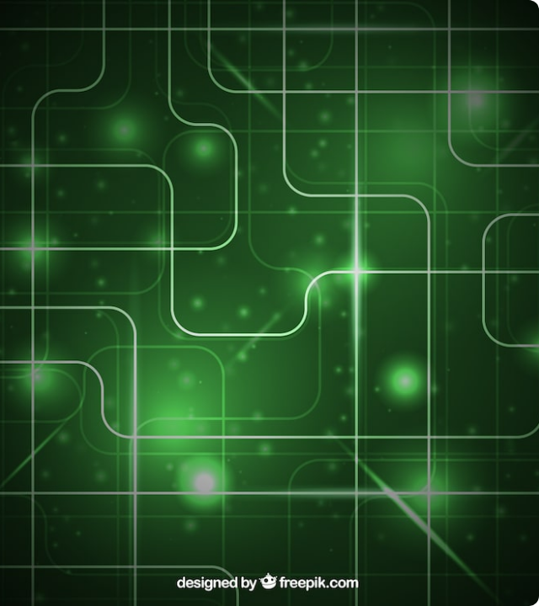
THE TURNING POINT
What if GPUs could do more than graphics?
GPUs were designed for graphics but contained enormous parallel math capacity. Researchers began using GPUs for non-graphics workloads.
AI researchers realized that training neural networks was a natural fit for massively parallel GPU computation.
NVIDIA had accidentally built a machine for the future of AI.

Slide 6
"The AI boom did not create NVIDIA's strategy — it revealed what NVIDIA had already built."
Gaming → GPU → CUDA → Deep Learning → Modern AI

Slide 7

CUDA — THE TECHNOLOGY THAT CHANGED EVERYTHING
Historically, GPUs were locked behind graphics languages. Developers wanting processing power for general math had to disguise calculations as pixels.
Enter CUDA (2006): The Game Changer
A software platform and programming interface created by NVIDIA.
Allowed developers to write standard code and run it directly on the GPU.
Completely bypassed the need to know anything about graphics rendering.

Slide 8






THE MENTAL MODEL
The CPU
The GPU
CUDA
CPUs are incredibly capable and can solve highly complex, multi-step logical problems.
They cannot solve complex logical puzzles on their own, but they are exceptionally fast at basic arithmetic.
The compiler architecture and API that bridges the CPU (Host) and GPU (Device).
However, they work sequentially—meaning they tackle one problem at a time.
It automatically splits standard C++ code and translates parallel tasks into GPU-readable instructions.
Because there are thousands of cores, they execute massive amounts of simple calculations simultaneously.

Slide 9


WALL STREET HATED CUDA
A Billion-Dollar Sinkhole
CUDA was initially viewed as a massive failure. Adding compute logic to silicon made every gaming GPU more expensive to manufacture, and gamers didn’t care about scientific computing.
NVIDIA’s profits tanked, and Wall Street punished the stock. Investors demanded NVIDIA drop the project.
Jensen Huang refused. He forced CUDA into every single chip they made, secretly laying the exact infrastructure that AI researchers would desperately need a decade later.

Slide 10
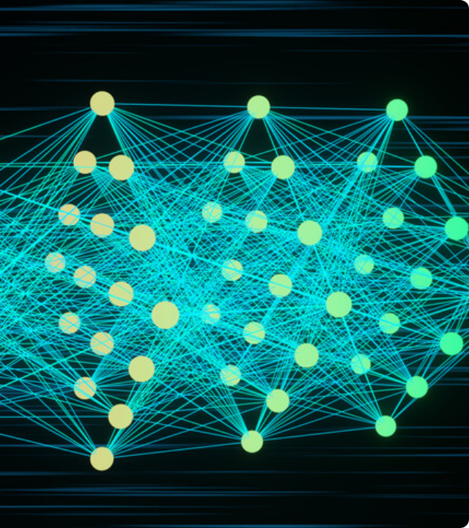
THE 2012 "BIG BANG" OF AI
Researchers led by Geoffrey Hinton entered the ImageNet visual recognition competition.
They introduced "AlexNet"—a deep convolutional neural network that crushed the competition, proving deep learning was the future.
6 days, 2 gaming GPUs, and a changed world.
The team trained AlexNet simultaneously on two off-the-shelf NVIDIA gaming GPUs (GTX 580s) for nearly a week. This event officially sparked the modern AI revolution.

Slide 11
COMPUTATION ON A GPU
Simultaneous Execution
Massive, Repetitive Matrix Math
Instead of processing this data sequentially, the GPU takes the massive grid, breaks it into thousands of tiny, independent tasks, and feeds them to its thousands of cores.
When an AI model runs a computation, it isn't solving complex sequential logic; it is crunching massive grids of numbers through simple arithmetic over and over again.
It computes the entire grid simultaneously rather than piece-by-piece.

Slide 12
"Hardware is replaceable; ecosystems are sticky."
Hardware is easily copied, but software creates a protective moat. By building essential AI libraries on top of CUDA, NVIDIA deeply integrated itself into every major AI framework. Rivals can't just build a faster chip—they must convince millions of developers to abandon the software ecosystem they already rely on.

Slide 13




NVIDIA TODAY — THE AI INFRASTRUCTURE GIANT
AI Accelerators
AI Data Centers
Specialized GPUs and Tensor Cores provide the massive parallel computing required by modern AI architectures.
Thousands of accelerators + high-speed networking + massive power & cooling make modern infrastructure possible.
Training → Inference
Physical AI
NVIDIA GPUs train large AI models and then run billions of AI queries efficiently as demand grows for active reasoning.
NVIDIA is extending AI into robotics, autonomous vehicles, and industrial machines to interact with the real world.

Slide 14




THE FUTURE — WHAT'S THE NEXT CUDA?
Competition
AI Everywhere
As the market expands, competitors are racing to break the software moat and develop alternative compute ecosystems.
The transition from isolated data centers to edge computing, putting intelligent parallel processing in every device globally.

